Slide 1
Spot-check tool
30 Sep 2026

Slide 2
Spot-Check tool
Overview:
Spot-Check tool is a desktop quality-assurance application for comparing an English technical-manual PDF against one or more translated PDFs. It detects missing TOC topics, hyperlinks, barcode and QR-code counts, missing/extra/moved graphics, image-count mismatches, layout-region defects, text collisions and untranslated text against source (English pdf). This supports customization for different stylesheets.
Key Capabilities:
Input and batch processing
TOC and hyperlinks missing identification
Barcode and QR-code checks
Graphic extraction and comparison
Symmetric image counts
Stylesheet Region Inspector
Text quality checks (overlap and non-translations)
Business Challenge:
Massive Human Effort: Comparing a 120-to-150-page manual against its translation manually can take up to 1 to 1.5 hour per language. When there are such 30 translated files, it can take up to 3 days.
Expected Business Value:
Reduces time taken for review of each document
Zero-miss detection across QR and barcodes, TOC numeric, non-translated text, markup region and text collision.
It achieves 90% accuracy on results and eliminates human error.
Objective:
Automate the visual and layout quality inspection of multi-language technical manuals against master English PDFs to minimize manual review effort, eliminate human error, and ensure 100% documentation fidelity.

Slide 3
Flow Chart
If it is new style sheet Manual interruption is need to mark-up the required region or if not, need to verify the region are correctly placed.
One time tool setup
No Manual interruption required
Completely automated
Configuration Setup
Mark-up the review regions in region inspector
Click the start button
Output: Shows the result in review tab and saves the result in an excel file as well.
BEFORE THIS TOOL:
AFTER THIS TOOL:
Workflow: Render-Review all translated PDFs-Publish
Manual hours required: Approx. 1 to 1.5 hr per pdf (of 150 pages)
Overall duration: Approximately 2–3 days for 30 PDFs
Process involves manual review for every translated language
High effort and straining workflow
Prone to human error and inconsistencies
Workflow: Render-Spot check tool-Review of only sample files-Publish
Tool time require: Approx. 2 mins per PDF (of 150 pages)
Manual hours required: 1 to 1.5 hr per file - but only for sample files
(For adjusting markup if any, manual review time to review tables, chunk topic, version codes, measurements units… )
Overall duration: Approximately 6-7 hours for 30 PDFs
95% Hit rate, 90% accurate results
Significantly reduces human overlook especially with stylesheet review
Only need to verify the tables, missing chunk topics and values.
FUTURE IMPROVEMENTS:
Table detection
Chuck topic missing identification
Missing reference detection
Comparing measurement units, values, version codes consistently

Slide 4
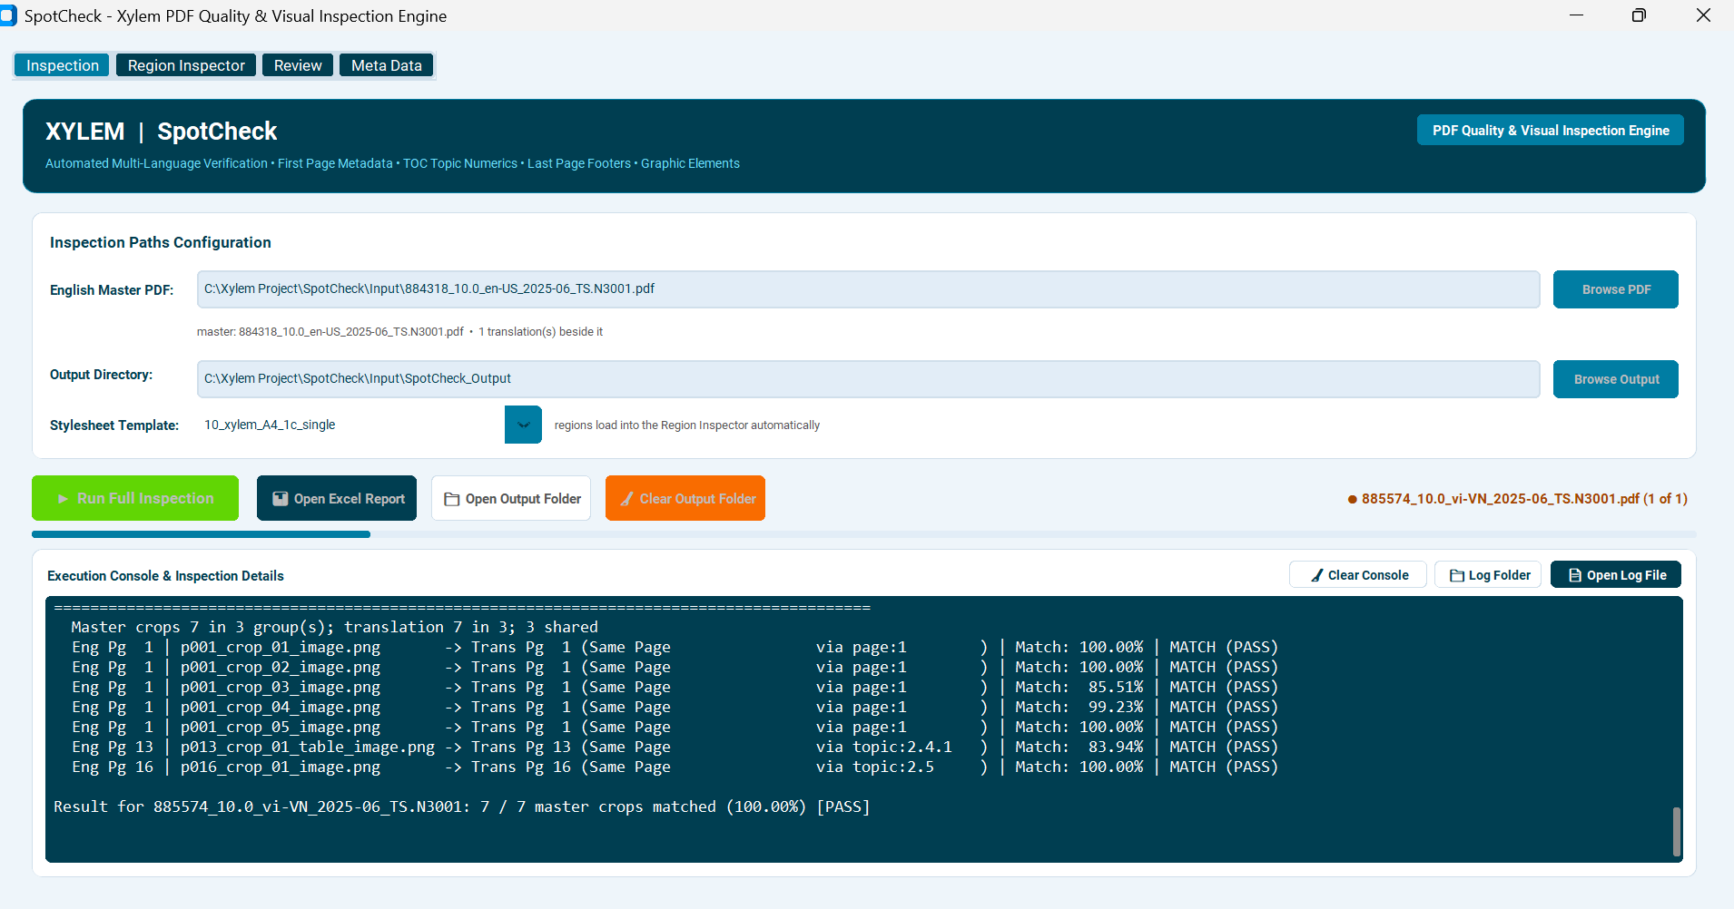
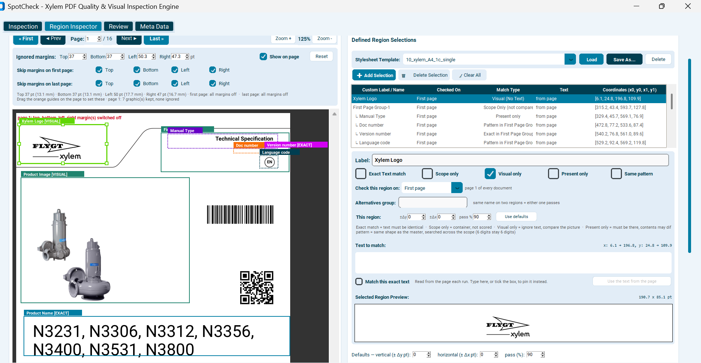
GUI:
GUI:

Slide 5
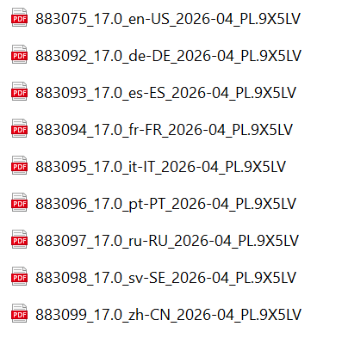
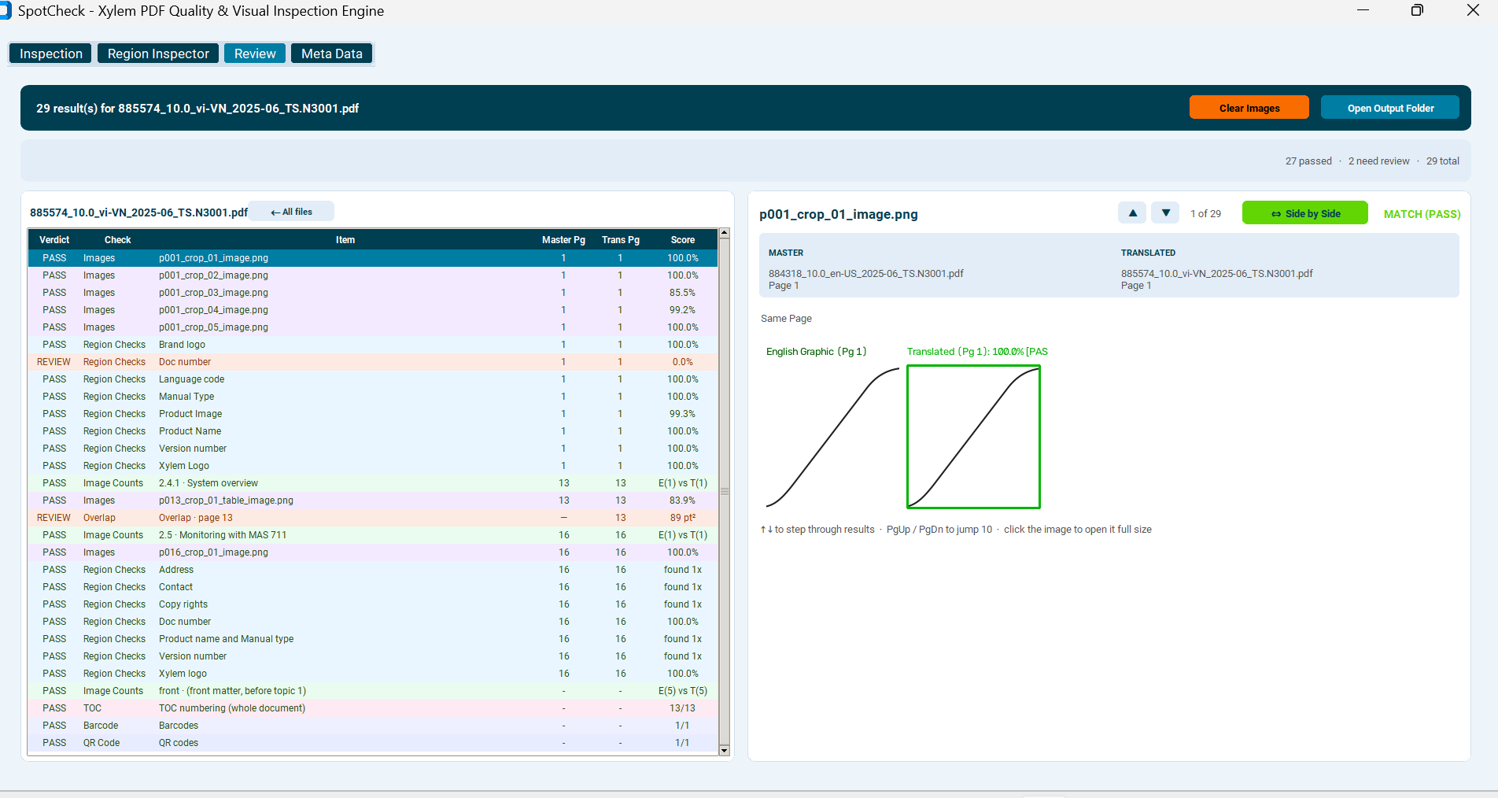

Input:
Highlighted text with review stamp, per template
Output

Slide 6
Demo

Slide 7
Q&A

Slide 8
Thank you

